Slide 1
Advanced Higher CS

Slide 2
Plan
Software Design and Development
Database Design and Development
Exam
Integration
Project

Slide 3
Assessment
Project – 60%
Question Paper – 40%
SDD
DDD
Marks 80
SDD 64%
DDD 36%
Marks 55
Final grade out of 135

Slide 4
SDD Analysis
Advanced Higher (Python)

Slide 5
Learning Intentions
Describe, exemplify and implement Unified Modelling Language (UML) use case diagrams:
actors
use cases
relationships
Notes:
https://www.omg.org/spec/UML/2.5.1/PDF#page=681

Slide 6
Use Case Diagram
specifies behaviours – triggered by a user
observable results of value to a user – End User Requirements

Slide 7
Use Case Diagram
shows End User requirements
shows how a user interacts with the system
a way to capture the requirements of a system
a specification of behaviour
an Actor is a user that interacts with the system
an Actor is a role: a person, a thing, a database, …

Slide 8

Use Case Diagram – Overview
System Boundary
Association
Use Case
Actor
Notes:
UML use case diagrams: www.youtube.com/watch?v=4emxjxonNRI
Can use an icon to represent what the Actor does

Slide 9
Use Case Diagram – Overview
Notes:
UML use case diagrams: www.youtube.com/watch?v=4emxjxonNRI
Can use an icon to represent what the Actor does

Slide 10
Actors
System Boundary
Initiates
Responds
Use Case 1
Use Case 2
Use Case 3
Primary Actor(s)
Secondary Actor(s)
Use the system
Support the system
Notes:
Primary: LHS Secondary: RHS

Slide 11






Actors
System Boundary
Use Case 1
Use Case 2
Use Case 3
Notes:
Primary: LHS Secondary: RHS

Slide 12
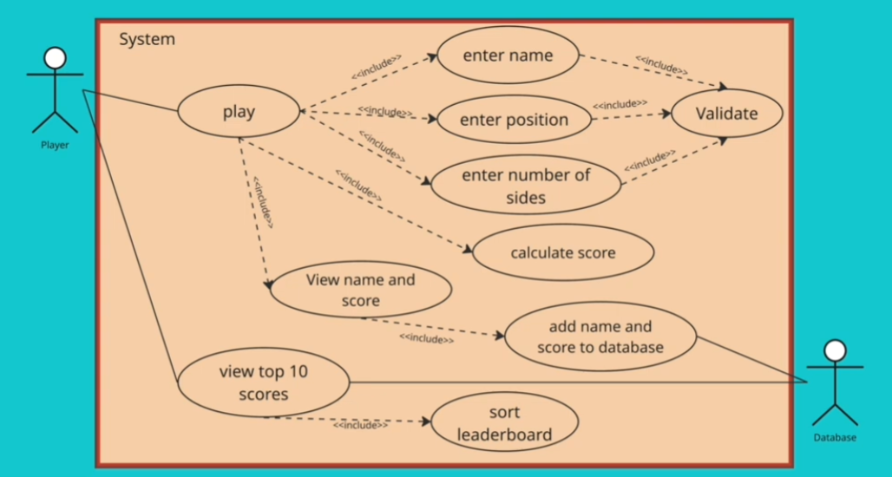
Notes:
22:30 - https://www.youtube.com/watch?v=OGGZVYlZbAY

Slide 13
Actor - Description
An actor uses the system to achieve an outcome.
An actor can be:
a person
an organisation
another system
Pupil
Prefect
Use the system
Support the system

Slide 14
Use Cases - Relationships
Drinks Vending Machine
Pay
Optional
«include»
«extend»
Select drink
Print receipt
Mandatory
Notes:
Arrow points to what must be done.

Slide 15
Use Case - Description
A use case represents an action.
Text: Verb – Action
Logical order: top to bottom

Slide 16
Relationship Types - Description
Association
Include
Extend
Generalisation
Pupil
Prefect
Support the system

Slide 17
SDD Design
Advanced Higher (Python)

Slide 18
Learning Intentions
Describe, exemplify, and implement UML for class diagrams:
class name
instance variables and data types
methods
public and private
constructor
Notes:
https://www.omg.org/spec/UML/2.5.1/PDF#page=236

Slide 19
Class – Overview
A template for objects with similar characteristics
An object can be tangible or intangible
Abstraction: ignore irrelevant characteristics*
* irrelevant from a design point of view

Slide 20






Classes – School Example
AH CS
Leila
Pupils are enrolled
on courses
N5 Maths
Archie
Pupils
Courses
Pupil
Course
Abstraction
Notes:
Similar to ERD
https://www.edx.org/learn/software-engineering/ku-leuven-uml-class-diagrams-for-software-engineering

Slide 21
Classes – School Example

Slide 22
UML Class Diagram – Overview
Class name
Name
Attributes /
fields /
instance variables
Properties
Nouns
Functions / Procedures
Verbs
Methods
Notes:
https://www.youtube.com/watch?v=6XrL5jXmTwM

Slide 23
UML Class Diagram – Overview
Name
Attributes /
fields /
instance variables
Functions / Procedures

Slide 24
UML Class Diagram – Example
+ = public
- = private
Class name
Person
- forename: String
- surname: String
- age: Integer
Properties
(Data)
+ Person()
+ get_name(): String
+ get_age(): Integer
+ set_age(age: Integer): void
Constructor – class name
Return type
Methods
(Behaviour)
Parameter & type
Private properties / methods only accessible to the object!

Slide 25
UML Class Diagram – Example
Person
- forename: String
- surname: String
- age: Integer
+ Person()
+ get_name(): String
+ get_age(): Integer
+ set_age(age: Integer): void

Slide 26
Learning Intentions
Describe, exemplify, and implement UML for class diagrams:
array of objects
inheritance
Notes:
https://www.omg.org/spec/UML/2.5.1/PDF#page=236

Slide 27
UML Inheritance
Person
Superclass
- name: String
- age: Integer
A subclass inherits:
all properties
all methods
of the superclass
+ Person()
+ get_name()
+ get_age()
Inherits
Pupil
Subclass
Staff
- year_group: String
- subject: String
+ Pupil()
+ get_year_group()
+ Staff()
+ get_subject()

Slide 28
SDD Implementation
Advanced Higher (Python)

Slide 29
Style Guide
Class: ThisIsAClass
Property: this_is_a_property
Method: this_is_a_method
Two blank lines before / after a class / function
One blank line before / after a method
Maximum line length: 72 characters
Notes:
https://peps.python.org/pep-0008/

Slide 30
2D Arrays
Array of arrays
Grid of data:
Chess board
Cinema seats
Maps
Images
[[0,1,0]
[1,0,1]
[0,1,0]
[0,1,0]
[1,1,1]]

Slide 31
Learning Intentions
Describe, exemplify and implement standard algorithms:
bubble sort
insertion sort
binary search

Slide 32
Bubble Sort
Outer loop: Conditional
Inner loop: Fixed
Index | 0 | 1 | 2 | 3 | 4
Values | 51 | 3 | 29 | 18 | 21
 | 51
 |  | 3
 | 51 | 3
 | 3 | 51
 |  | 51
 |  |  | 29
 |  | 51 | 29
 |  | 29 | 51
 |  |  | 51
 |  |  |  | 18
 |  |  | 51 | 18
 |  |  | 18 | 51
 |  |  |  | 51
 |  |  |  |  | 21
 |  |  |  | 51 | 21
 |  |  |  | 21 | 51
 |  |  |  |  | 51
 | 3
 |  | 29
 | 3 | 29
 | 3 | 29
 |  | 29
 |  |  | 18
 |  | 29 | 18
 |  | 18 | 29
 |  |  | 29
 |  |  |  | 21
 |  |  | 29 | 21
 |  |  | 21 | 29
 |  |  |  | 29
 | 3
 |  | 18
 | 3 | 18
 | 3 | 18
 |  | 18
 |  |  | 21
 |  | 18 | 21
 | 3 | 18 | 21
Works left to right
Current value compared with next
The largest value 'bubbles' to the 'top'
Reduces by one element each time

Slide 33
Bubble Sort
Outer loop: Conditional
Inner loop: Fixed
Index | 0 | 1 | 2 | 3 | 4
Values | 51 | 3 | 29 | 18 | 21
Initial
Index | 0 | 1 | 2 | 3 | 4
Values
Sorted
Works
Current value
The largest value
Reduces by

Slide 34
Learning Intentions
Describe, exemplify and implement standard algorithms:
bubble sort
insertion sort
binary search

Slide 35
Insertion Sort
Outer: Fixed loop
Inner: Conditional loop
Index | 0 | 1 | 2 | 3 | 4
Values | 29 | 3 | 51 | 18 | 41
 |  | 3
 | 29
 | 29 | 3
 | 3 | 29
 |  |  | 51
 |  | 29
 |  | 29 | 51
 |  | 29 | 51
 |  |  |  | 18
 |  |  | 51
 |  |  | 51 | 18
 |  |  | 18 | 51
 |  |  | 18
 |  | 29
 |  | 29 | 18
 |  | 18 | 29
 |  | 18
 | 3
 | 3 | 18
 | 3 | 18
 |  |  |  |  | 41
 |  |  |  | 51
 |  |  |  | 51 | 41
 |  |  |  | 41 | 51
 |  |  |  | 41
 |  |  | 29
 |  |  | 29 | 41
 |  |  | 29 | 41
 | 3 | 18 | 29 | 41 | 51
Sorted
Unsorted
Sorted
Unsorted
Sorted
Unsorted
Sorted
Unsorted
First value always 'sorted'
First unsorted compared with last sorted value
Swaps right to left

Slide 36
Insertion Sort
Outer loop:
Inner loop:
Index | 0 | 1 | 2 | 3 | 4
Values | 29 | 3 | 51 | 18 | 41
First value
First unsorted
Swaps

Slide 37
Learning Intentions
Describe, exemplify and implement standard algorithms:
bubble sort
insertion sort
binary search

Slide 38
Binary Search
Values already sorted
Start
Middle
Start & End
Middle
Start
Middle
End
Index | 0 | 1 | 2 | 3 | 4 | 5 | 6
Values | 3 | 18 | 21 | 29 | 51 | 76 | 82
 | 0
 |  |  |  |  |  |  | 6
 |  |  |  | 3
 |  |  |  | 29
 | 0 |  |  | 3 | 4
 |  |  |  | 29
 |  |  |  |  |  | 5
 |  |  |  |  |  | 76
 |  |  |  |  |  | 5 | 6
 |  |  |  |  |  | 76
 |  |  |  |  | 4
 |  |  |  |  | 51
Target = 51
Middle = (Start + End) / 2
Middle value compared with target value
Start or End changed to Middle ± 1

Slide 39
Binary Search
Index | 0 | 1 | 2 | 3 | 4 | 5 | 6
Values | 3 | 18 | 21 | 29 | 51 | 76 | 82
1st
Index | 0 | 1 | 2 | 3 | 4 | 5 | 6
Values | 3 | 18 | 21 | 29 | 51 | 76 | 82
2nd
Middle
Middle
Start or End

Slide 40
Project Ideas
Meet AH requirements
Fulfil FRs
Think first sprint!
Movie site – search / sort
Hotel booking system
Dog care – track vet visits
Wordle / Variants
PC building
Book rental
Quiz
Lottery
Playlist editor
Golf ball shop
Connect 4
Sudoku: problem / solution data
Minesweeper
Uno – simplified
Fantasy football league
Own research linked to FRs – not tkinter!
More complexity != More marks
Notes:
Above and beyond can be on major (SDD) or minor (DDD). Two things: researched, documented, referenced, and implemented. Not a new library (Tkinter), use new commands!
1:17:30 https://www.youtube.com/watch?v=NtiUBg6dSrI
Project length could be 10 pages, if stick to the requirements!

Slide 41
Project Analysis

Slide 42
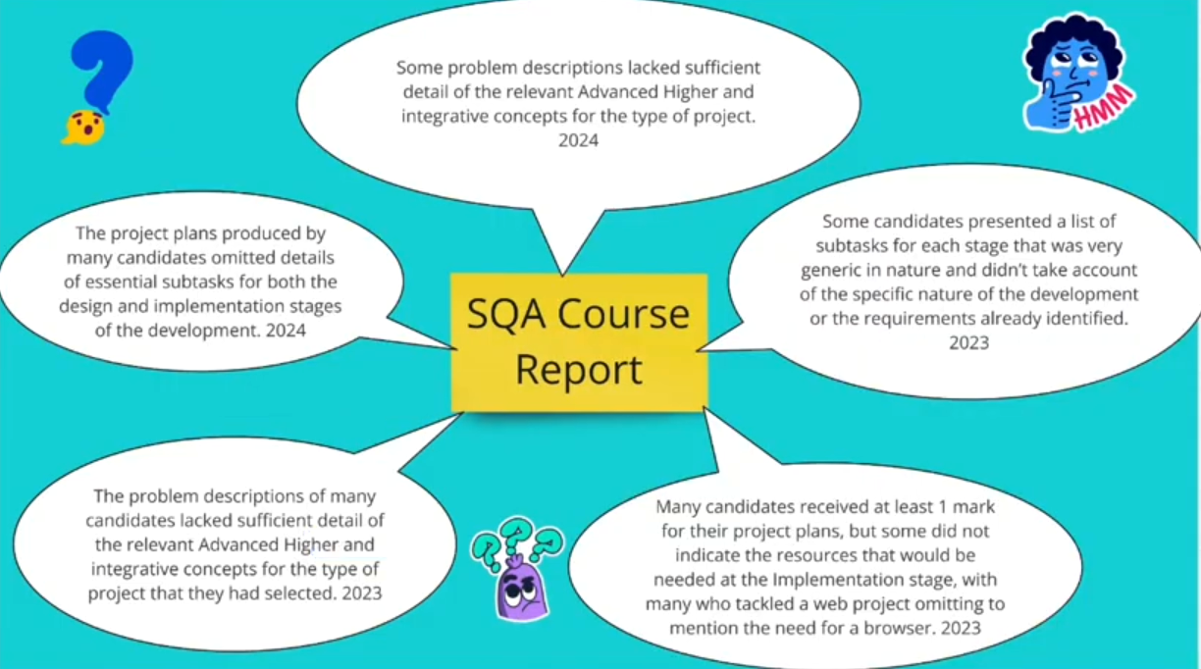
Course Report

Slide 43
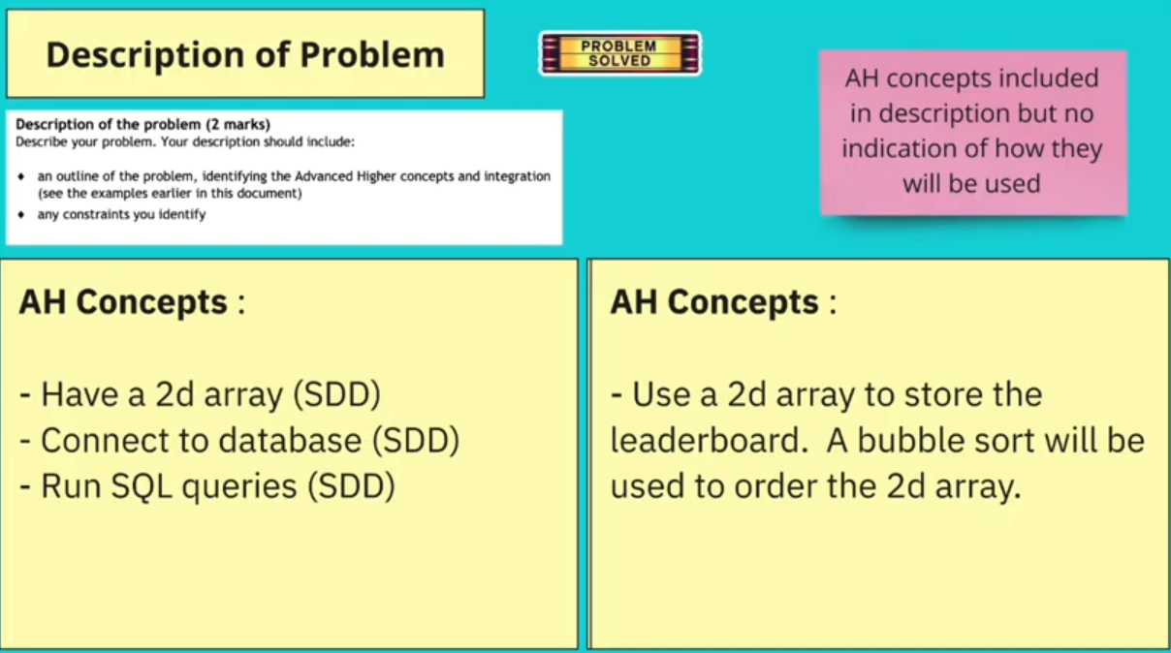
Description of Problem

Slide 44
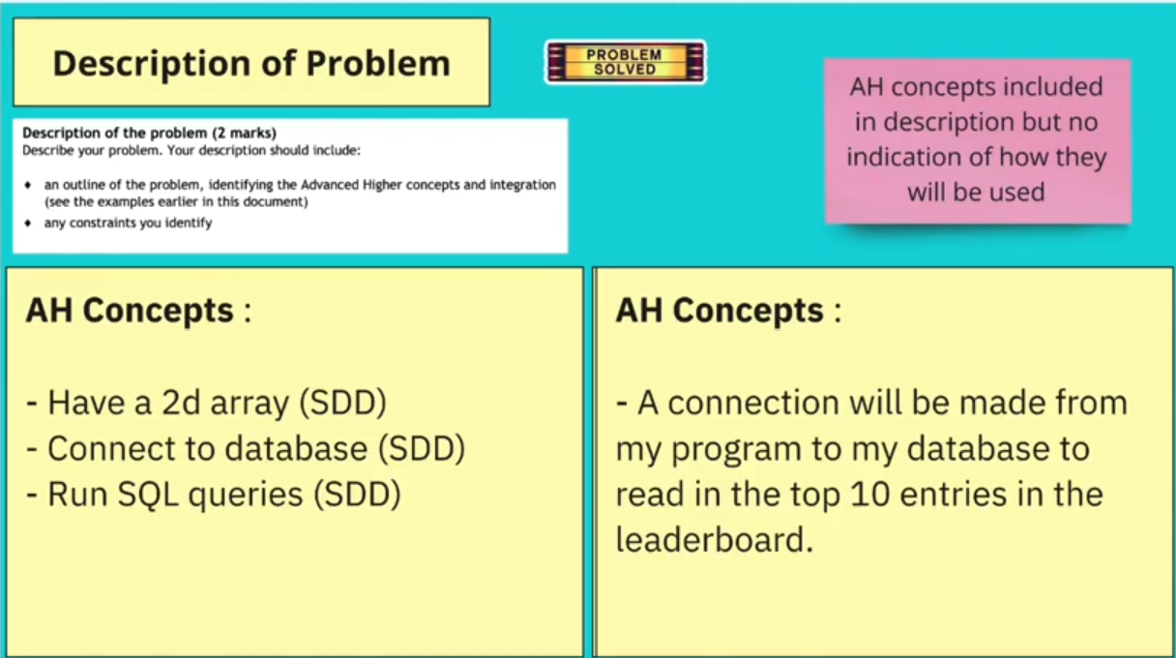

Description of Problem

Slide 45
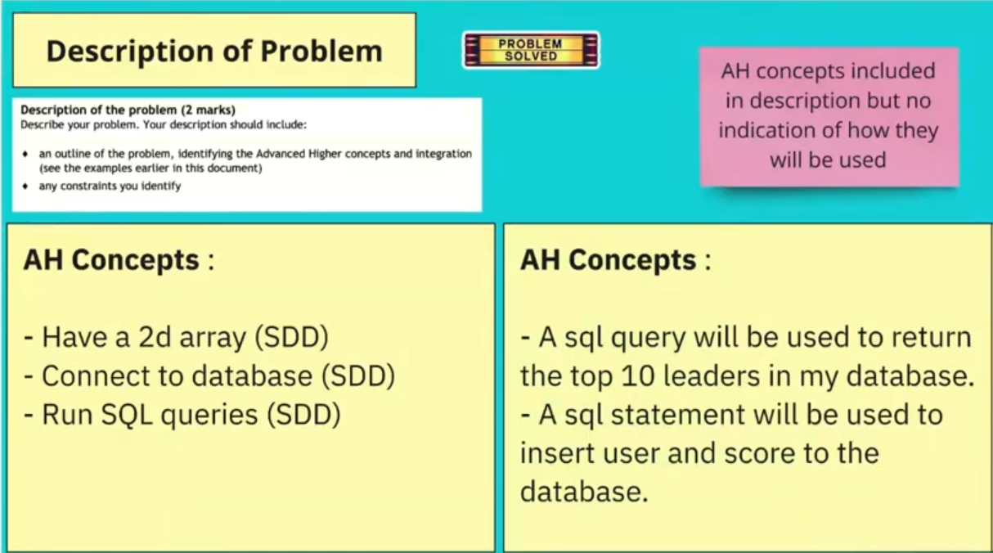

Description of Problem

Slide 46
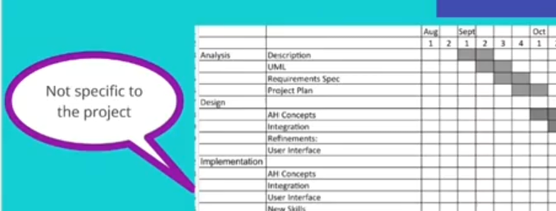















Project Plan

Slide 47
Project Design
DDD

Slide 48
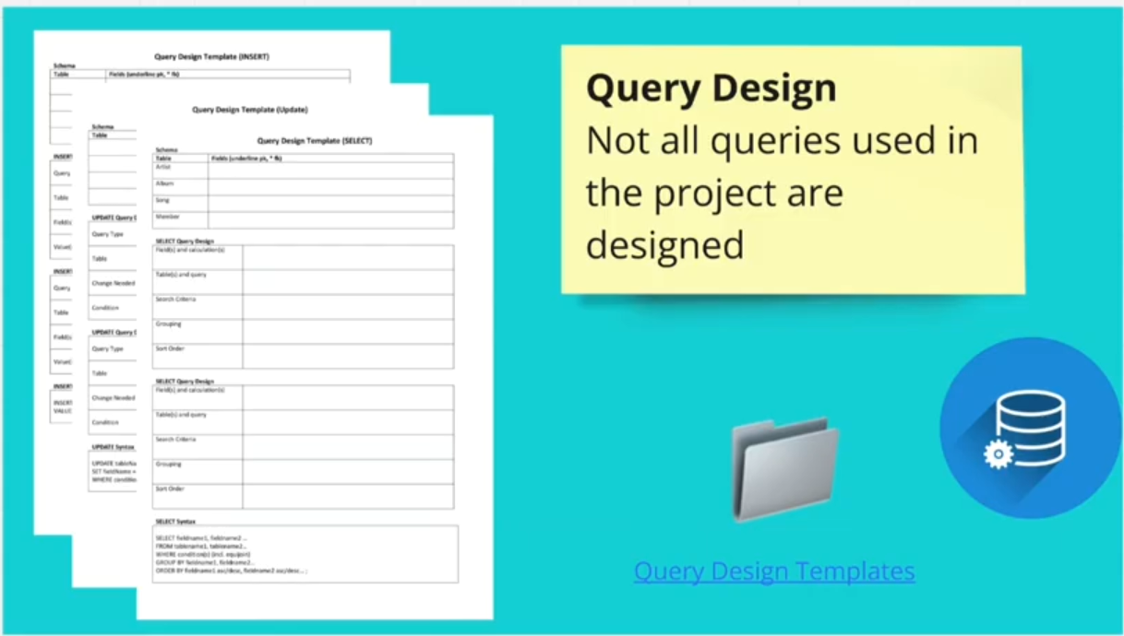










Query Design

Slide 49
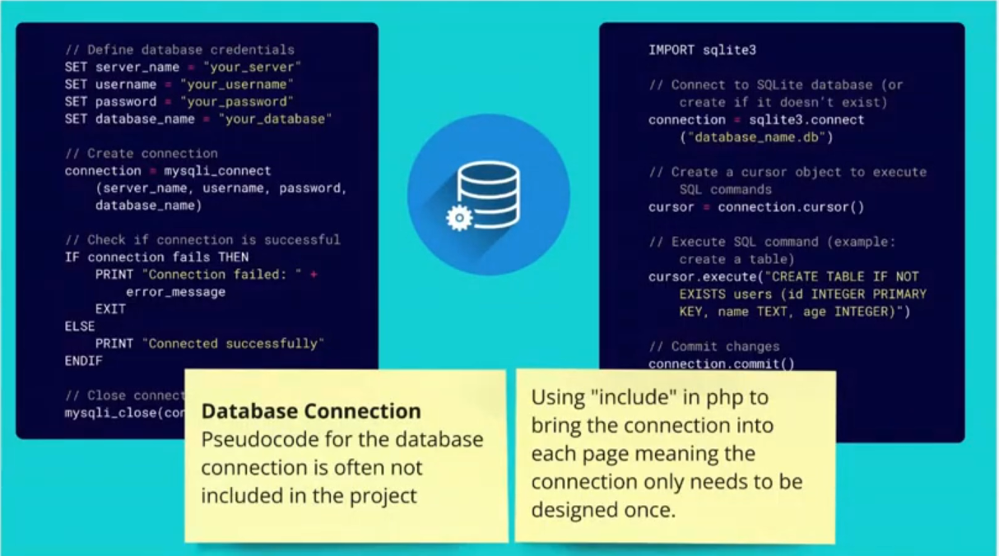
Database Connection

Slide 50
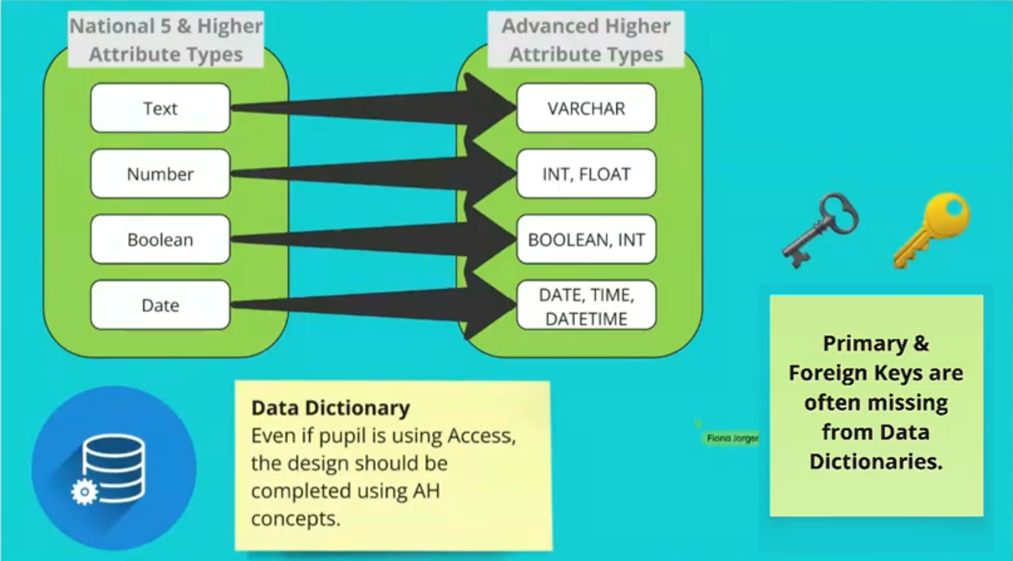


Data Dictionary

Slide 51
Project Design
SDD

Slide 52
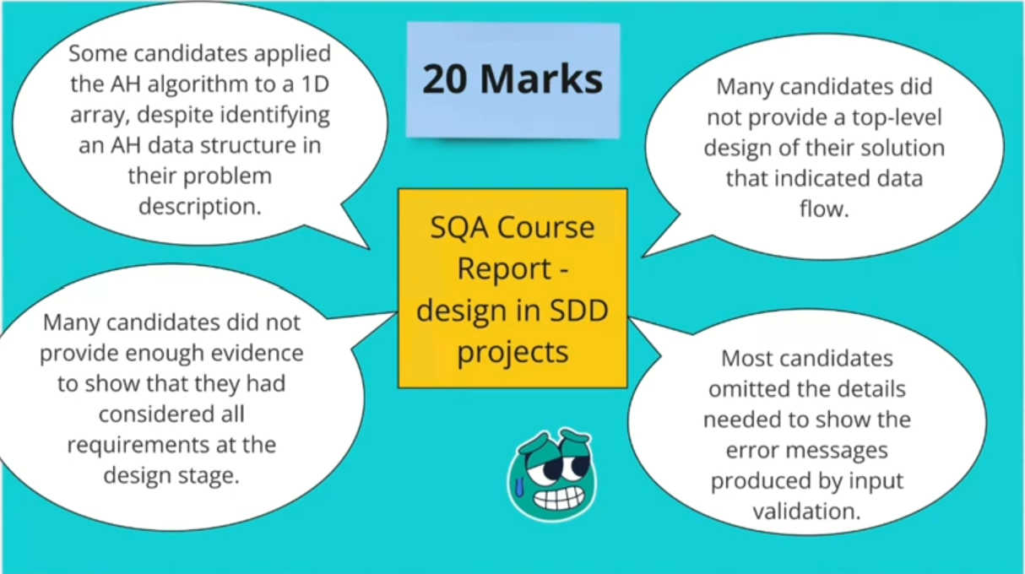
Course Report

Slide 53
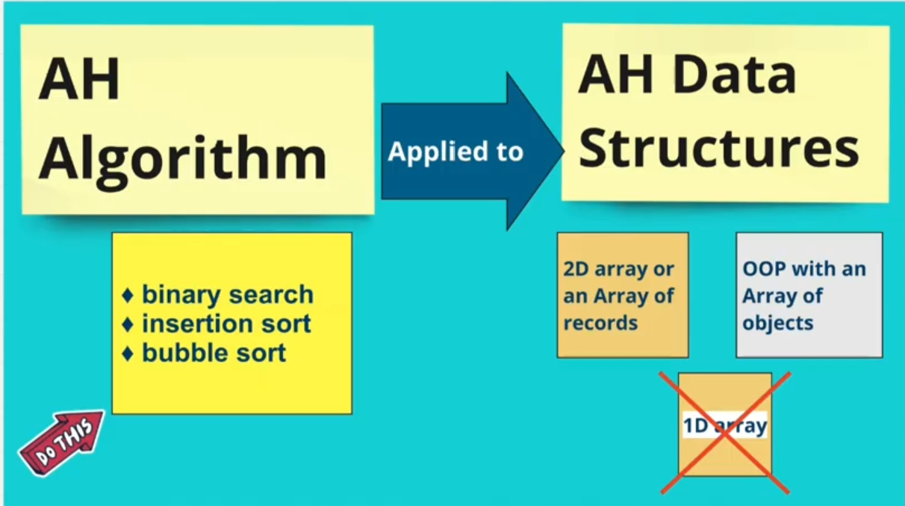
AH Algorithm

Slide 54
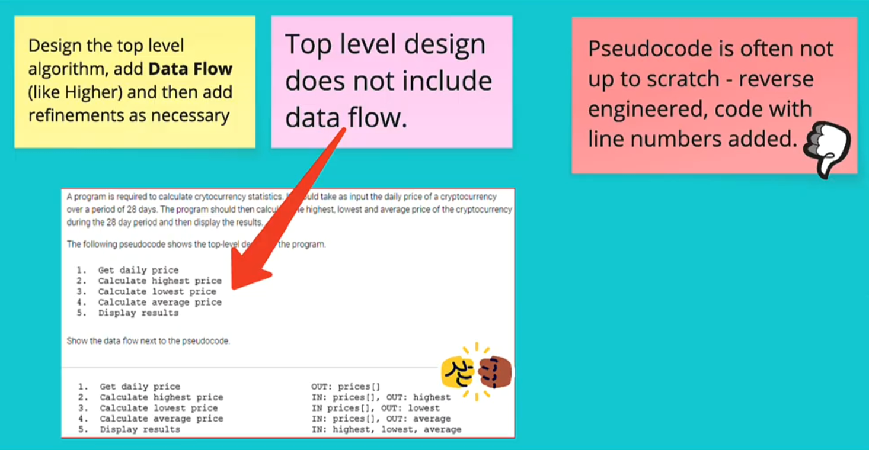
Data Flow

Slide 55
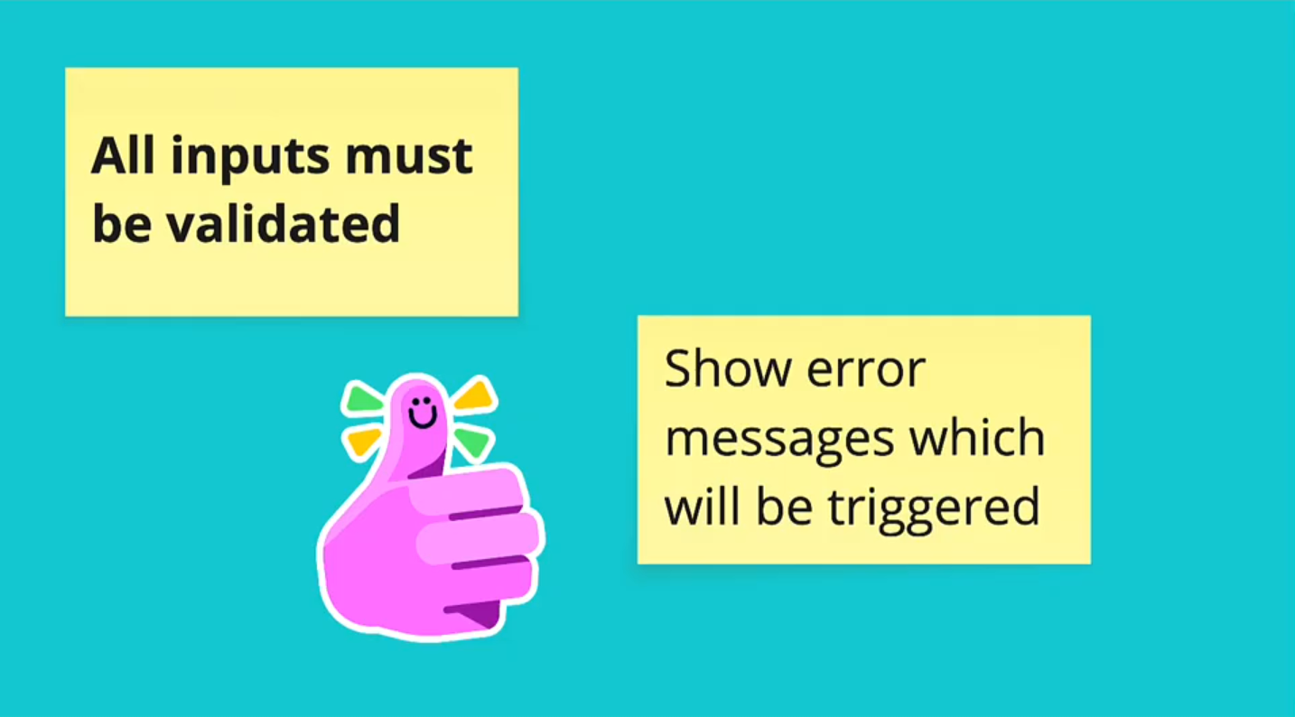
Input Validation

Slide 56
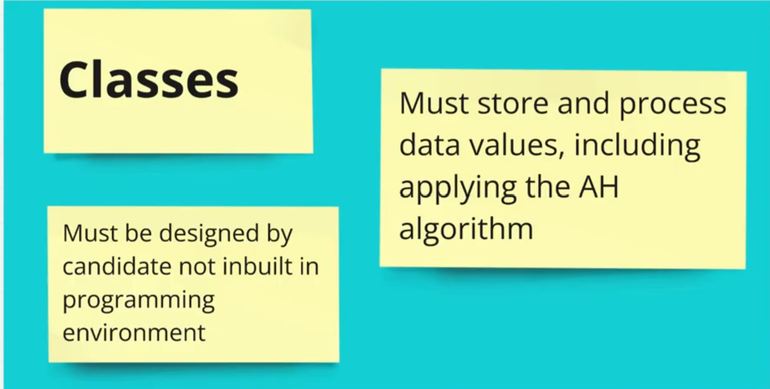
Classes

Slide 57
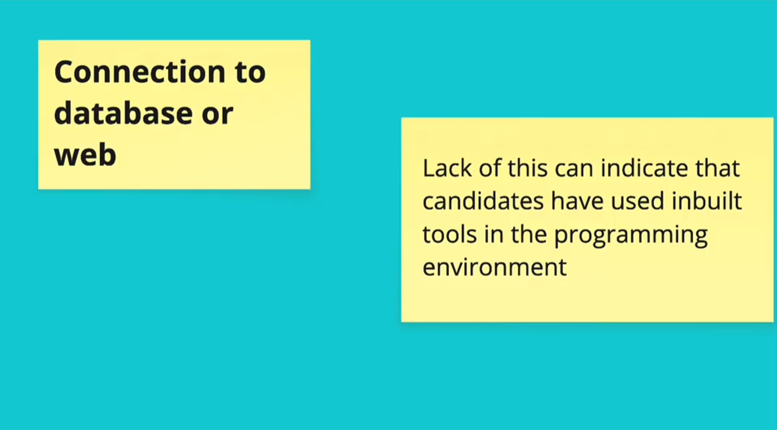









Database Connection

Slide 58
Project Implementation
SDD

Slide 59
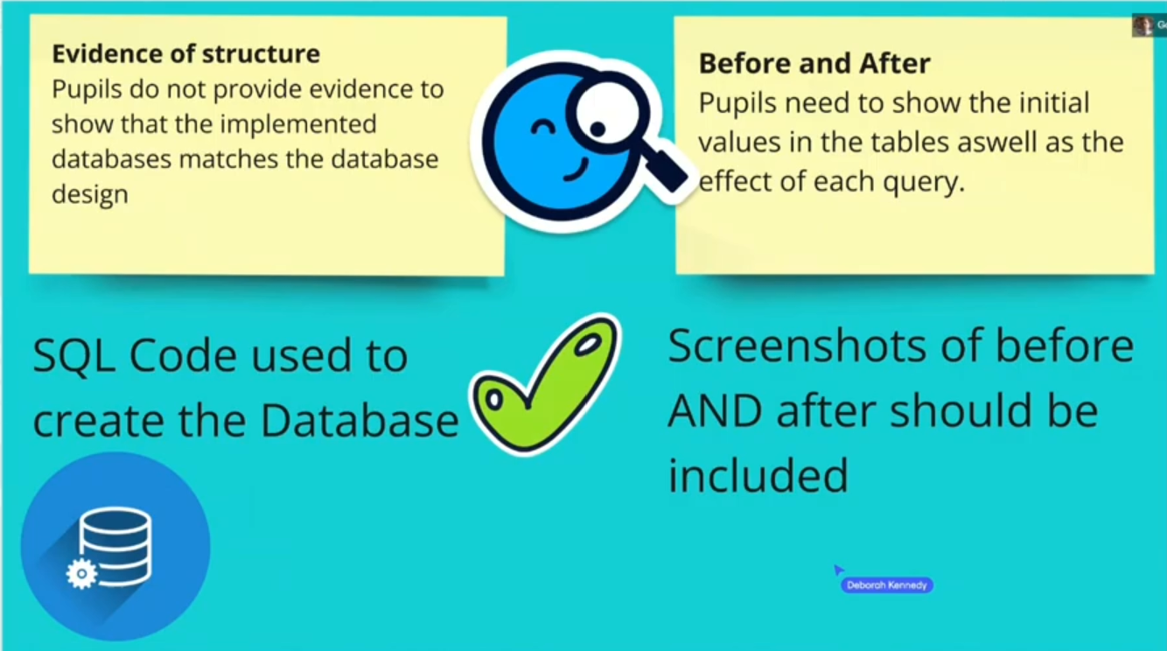

Database Structure

Slide 60
Project Implementation
SDD

Slide 61
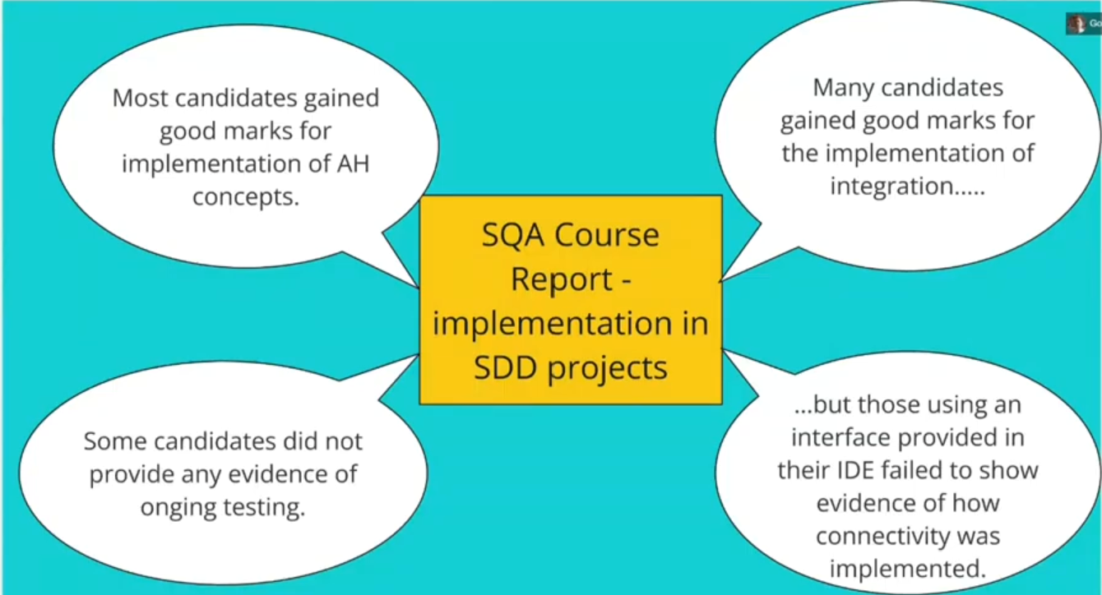
Course Report

Slide 62










Highlighting

Slide 63
Project Testing
SDD

Slide 64
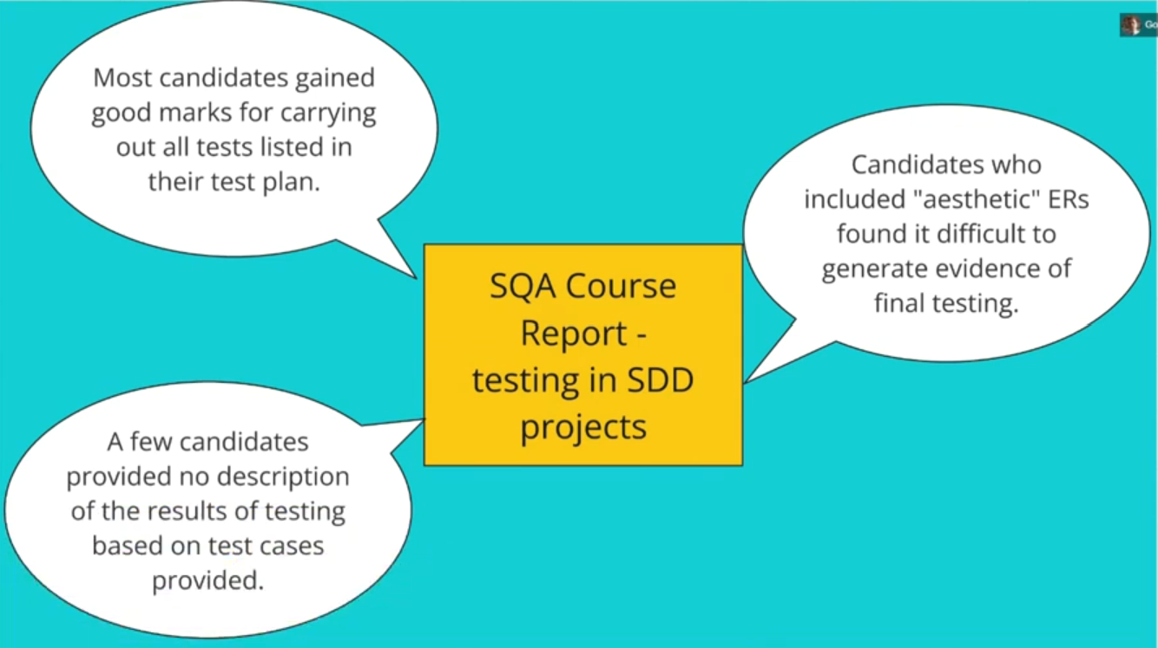
Course Report

Slide 65
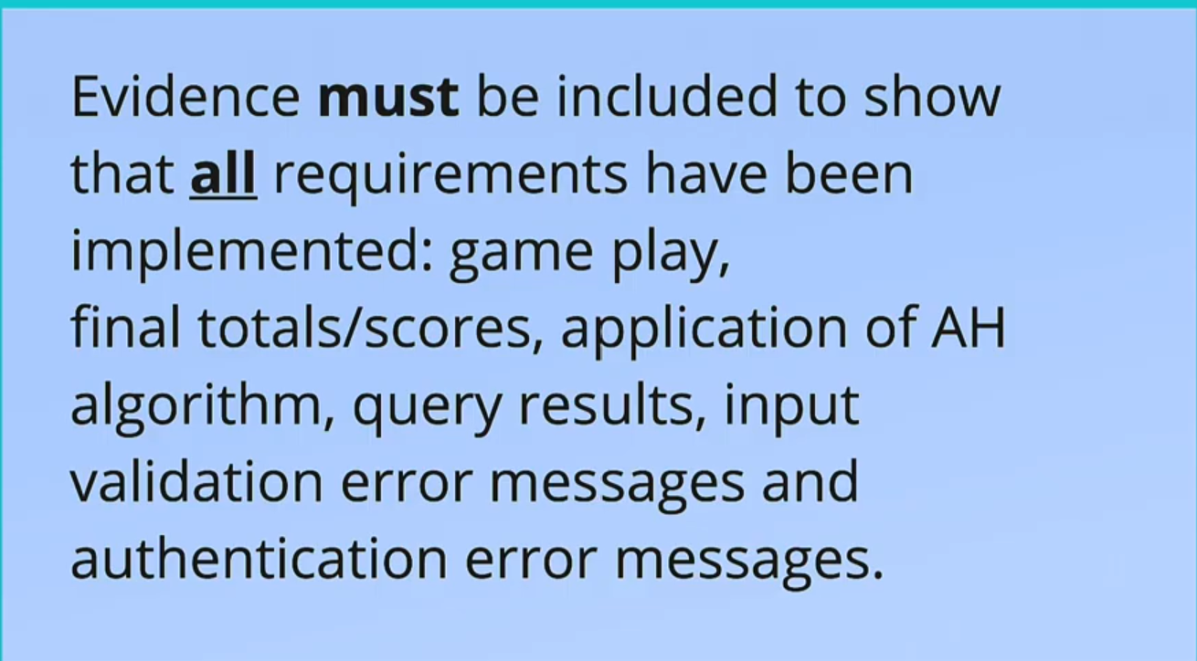


Evidence

Slide 66
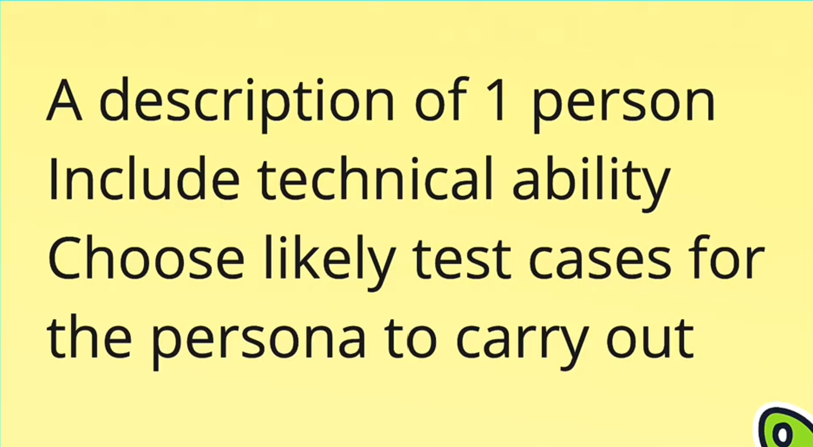
Pesona – End User Testing

Slide 67
Project Evaluation

Slide 68
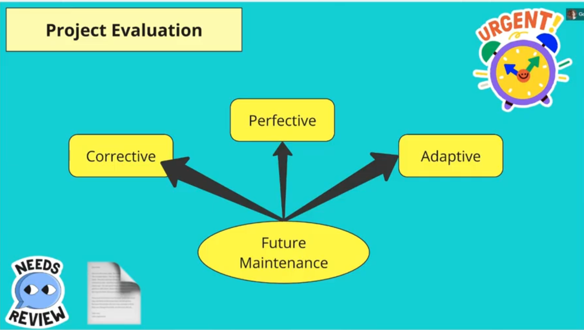

Overview

Slide 69
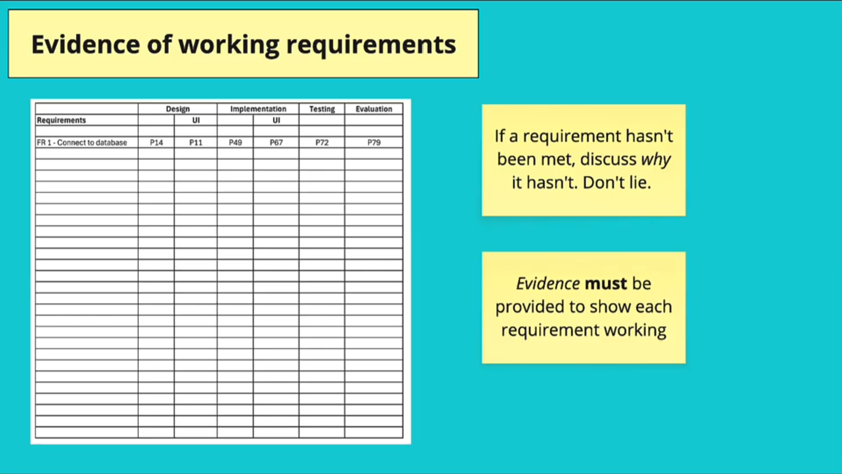
Evidence

